Slide 1
HEALTHCARE TECHNOLOGY MANAGEMENT LARGE LANGUAGE MODEL (HTM-LLM)
Team DVAMC
Chris Ahn

Slide 2
Overview
The Problem
A Helping Hand
Without it or with it?
How it’s Built
Demo
Conclusions and Next Steps

Slide 3
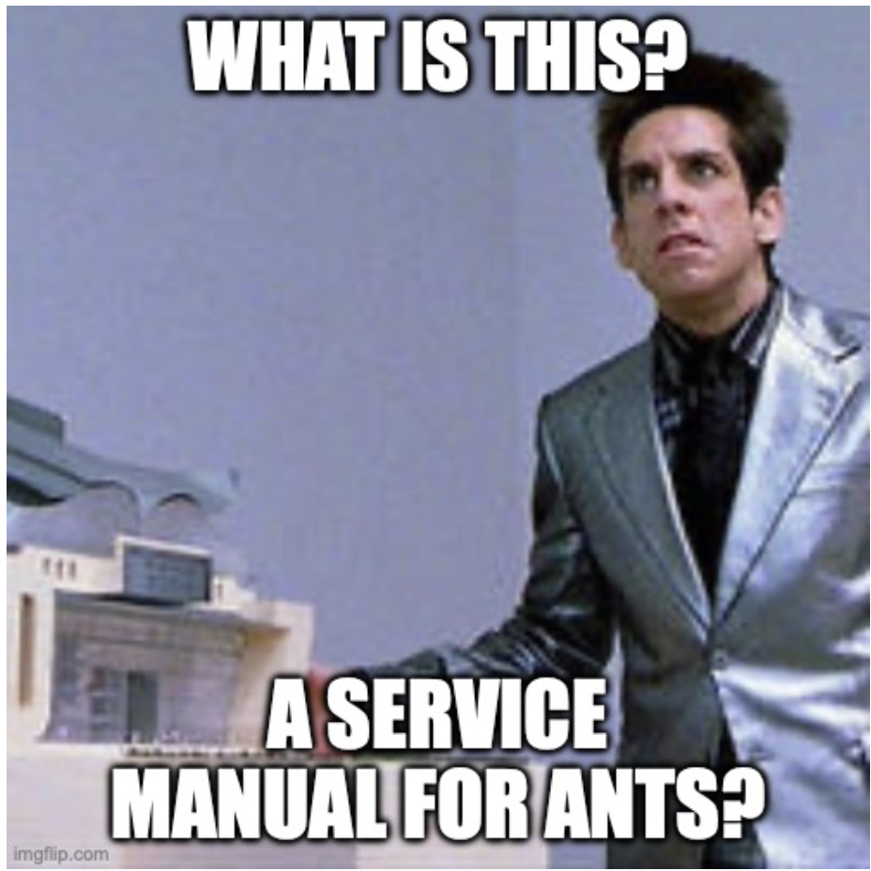
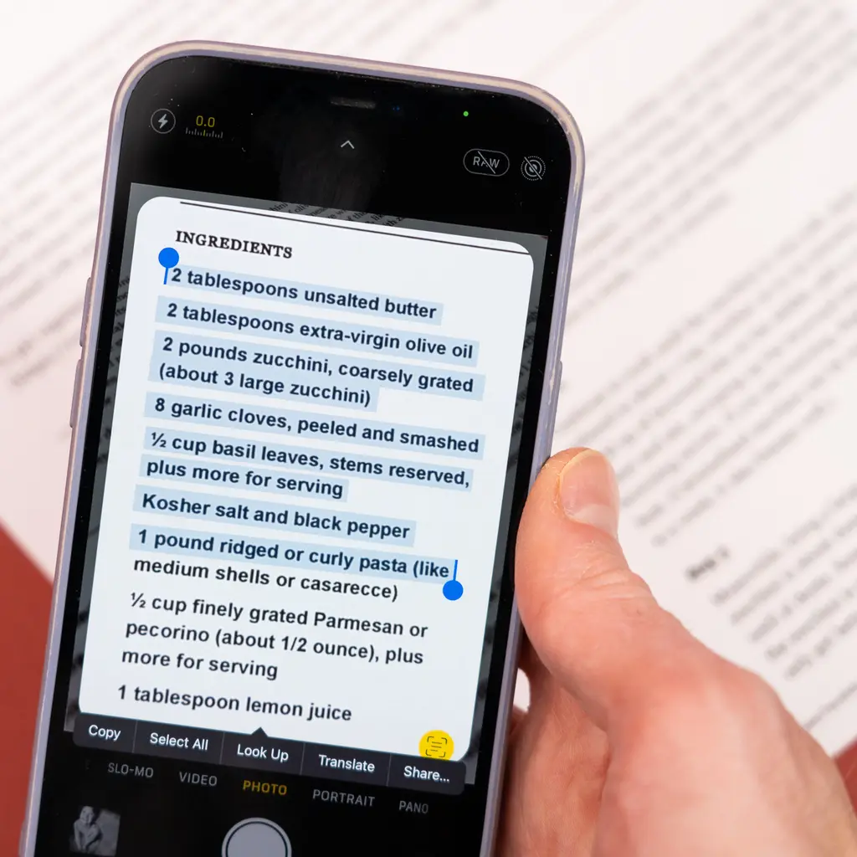
The Problem
Service manuals for medical devices can reach to the hundreds of pages or more
Using a paper copy loses the benefits of keyword search
Using a digital copy allows keyword search but search terms may appear in multiple places, and using a laptop or mobile phone can be unwieldy

Slide 4
A Helping hand
Enter HTM-LLM
Uses Retrieval Augmented Generation (RAG), with the medical device service manual as reference
Accessible via laptop or mobile for easy use
Gives time back to the technician

Slide 5

Without it or with it?
Without It
With It
Go to table of contents (print/digital) or enter keyword (digital)
Navigate to page (print/digital) or scroll through keyword hits (digital)
Find answer….
All on a tiny phone screen or balancing a laptop, sometimes in a patient care area.
Enter question into HTM-LLM
Receive answer

Slide 6



How it’s built (Architecture Diagram)
?
Chat Model (gpt4o)
Prompt Template
Question (Chainlit)
Context
Context References
Question
Embedding Model
(text-embeddings-3-small)
Vector Store
(Qdrant)
Answer (Chainlit)
Hosted on HuggingFace

Slide 7
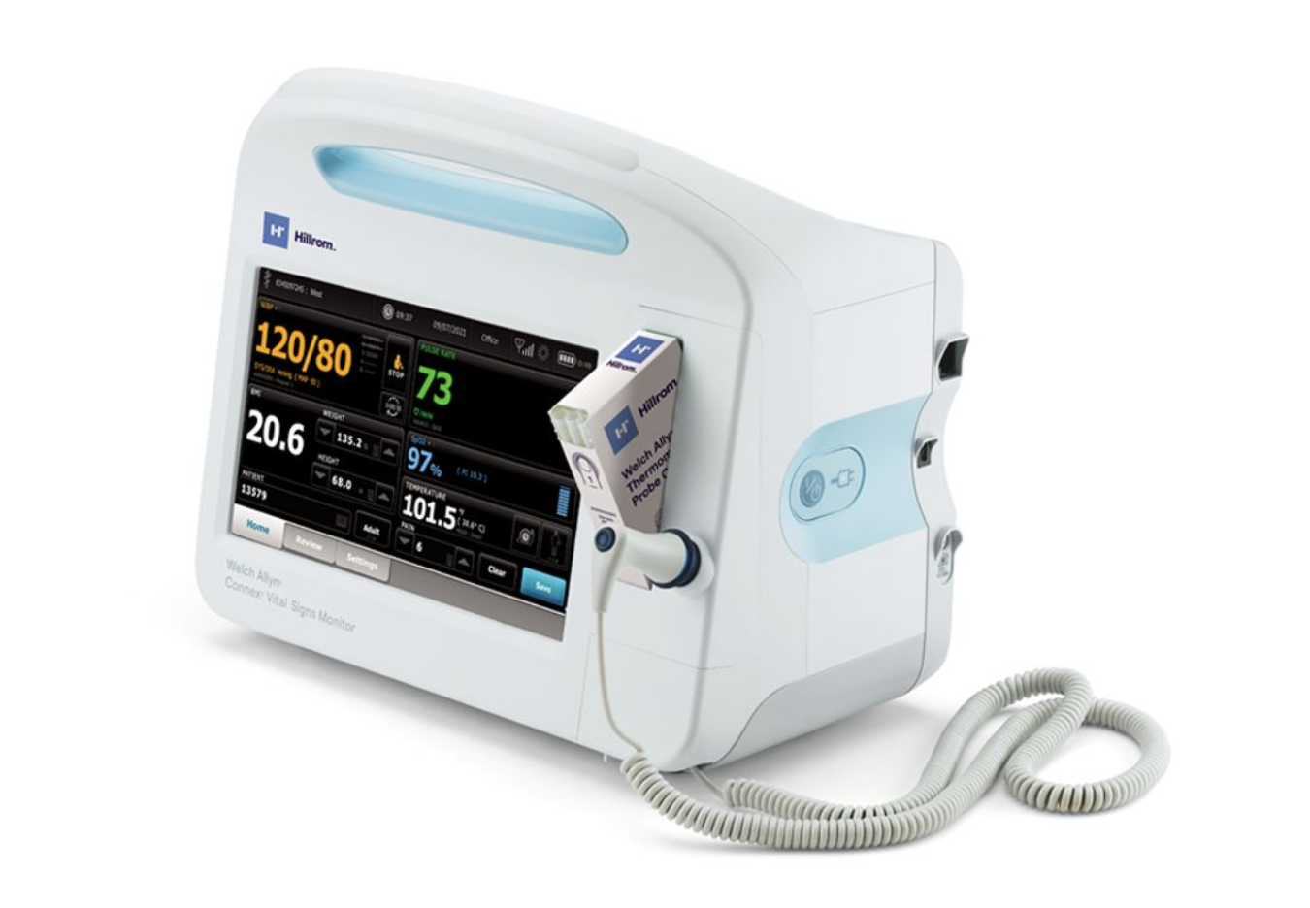
DEMo
What’s the default service password?
How do I access advanced NIBP settings?
The NIBP frame is blank. What’s wrong and how do I fix it?
How do I check the error logs?
How do I access the Service tab?
What’s the part number for the NIBP pump assembly?

Slide 8
Next steps
Expand the available service manuals
Use a menu / search system to show available manuals, and then use RAG just on that manual
Multimodal!

